Slide 1
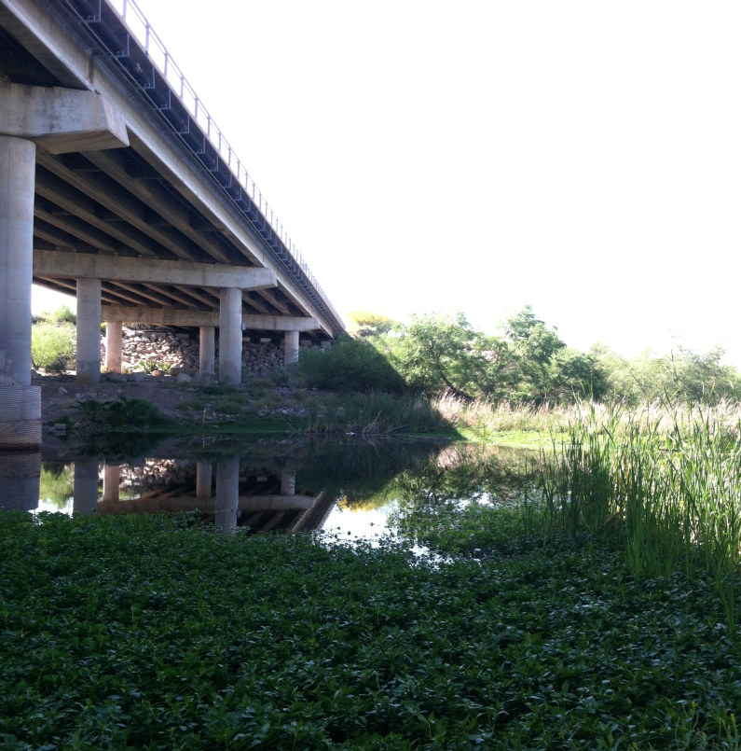
Characterization of DOC in Accidental Urban Wetlands in Phoenix, AZ Stephanie Bone
Committee Members:
Dr. Hilairy Hartnett, Dr. Monica Palta, Dr. Giuseppe Mascaro
Acknowledgments:
CANDY Lab (Carbon and Nitrogen Dynamics) and Lindsey Pollard

Slide 2
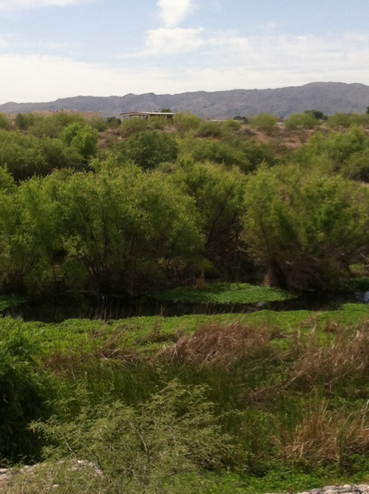
Why is it important ?
Dissolved organic carbon (DOC) is a major form of carbon transported in water
Can be an indicator for change in:
Seasonal conditions
Source of water
What did I do?
Sample water from Salt River during base and storm flow
Quantify and characterize DOC
-
-
Notes:
DOM- composed organic matter from terrestrial, atmospheric and autochthonous sources
DOM is metabolically important in rivers as it supplies energy (carbon) and nutrients to bacteria and algae contributing to eutrophication
Wetlands- important transitional zones from terrestrial and aquatic environments

Slide 3
What is an Accidental Urban Wetland?
Not planned nor actively managed
- Main source of water are
outfalls
Receive and modify materials
Municipal land use and water infrastructure decisions
Notes:
They are often formed in abandoned industrial areas that are low-lying in the landscape, where overland flows from municipal water use and storms accumulate and eventually support wetland soils and plant communities. Their positioning within the urban matrix means that accidental wetlands can both receive and modify materials from cities. Due to their pervasiveness and provision of ecosystem services of potential value, accidental wetlands merit consideration in urban management strategies

Slide 4
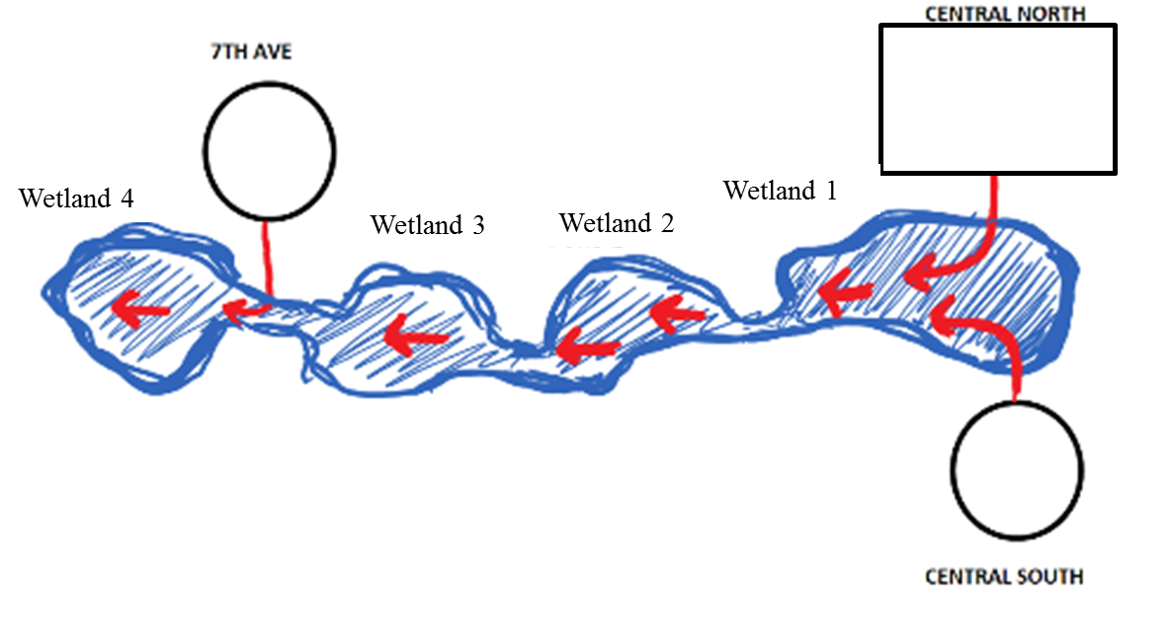
Research Questions
(1) Is there a difference in input? Are the outfalls that feed the wetland different?
(2) Is there change along the channel? From upstream to downstream?

Slide 5
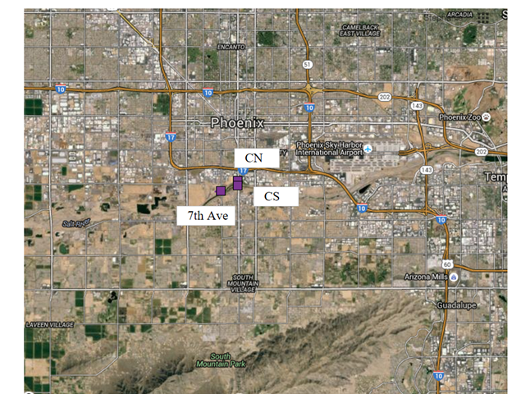
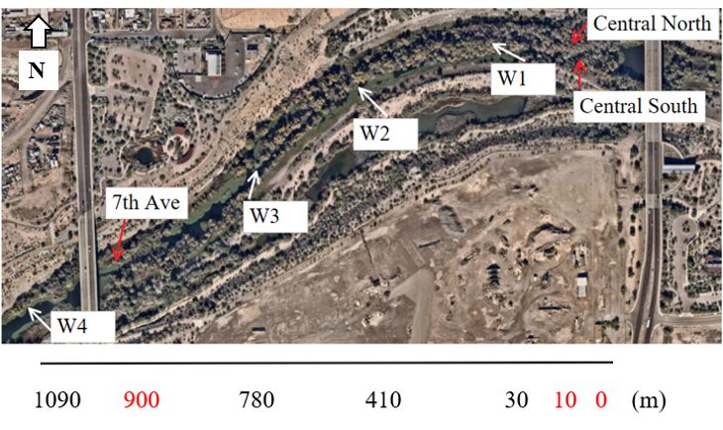
Sample Locations
Notes:
Salt River traversing Phoenix, AZ
Construction of Tempe Town Lake
Urban Expansion
Precipitation

Slide 6
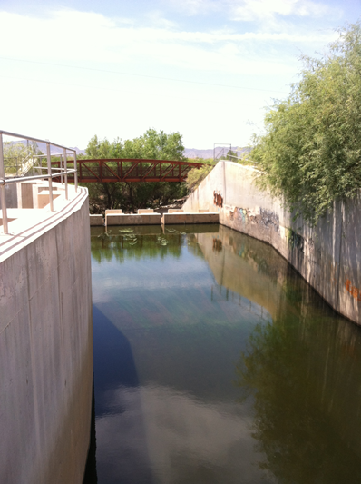
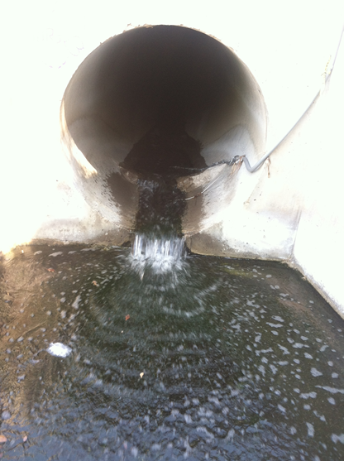
Outfalls
Central North
Central South
7th Ave

Slide 7
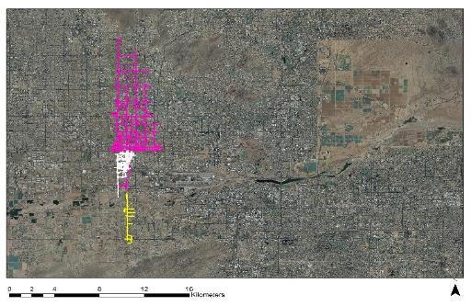
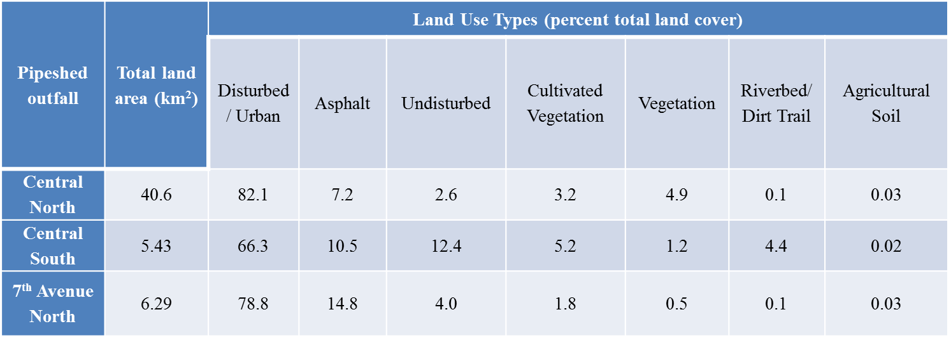
Pipesheds
Central North
Central South
Source: Monica Palta
Source: Monica Palta

Slide 8
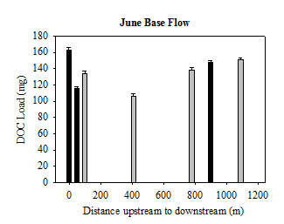
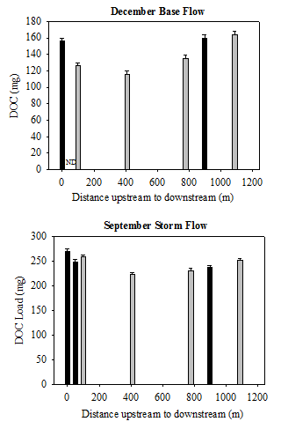
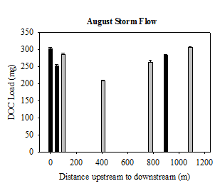
DOC Load Results

Slide 9
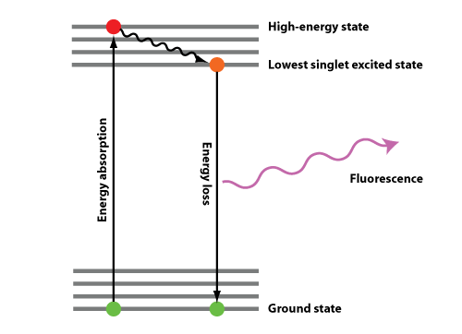
Excitation-Emission Matrix (EEMs) Spectroscopy
Source: Hilairy Hartnett
Fluorescence occurs when molecules absorb energy causing a molecule to be promoted to an excited state; as it returns to ground state, energy can be lost as light
Molecules have specific excitation & emission wavelengths

Slide 10
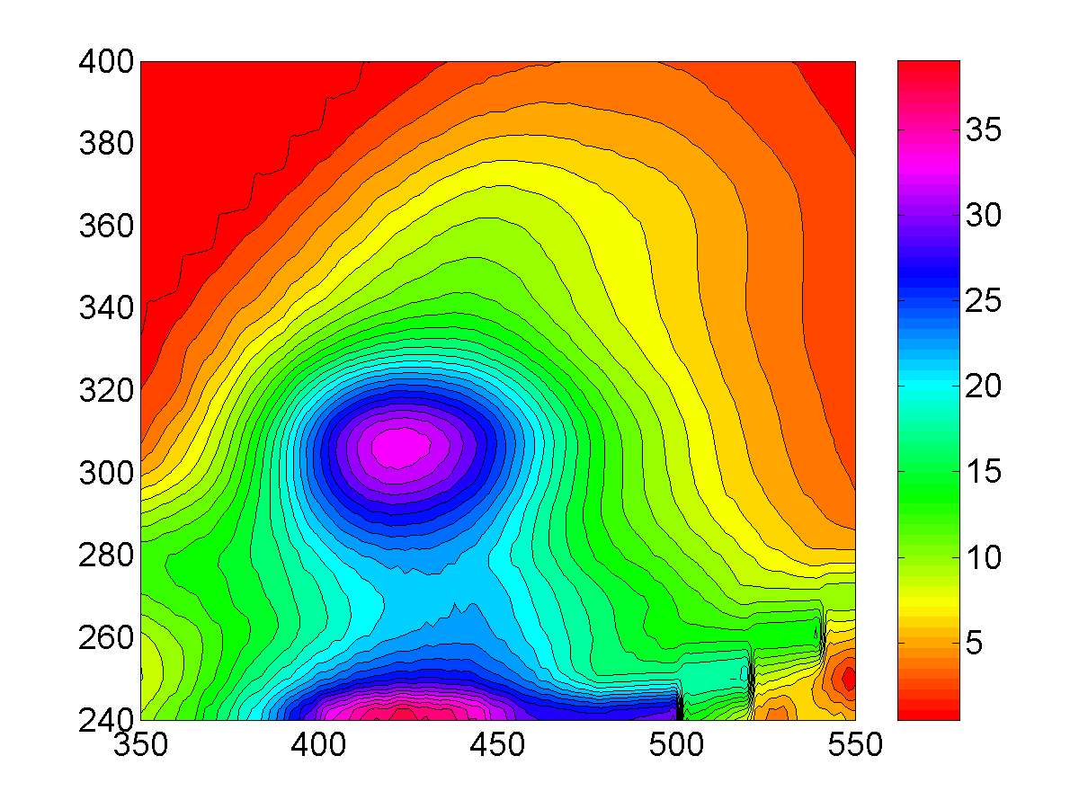
What does a DOC fluorescence spectrum look like?
Humic-like
(terrestrial)
Excitation (nm)
Protein-like
(microbial)
Emission (nm)
Source: Hilairy Hartnett

Slide 11
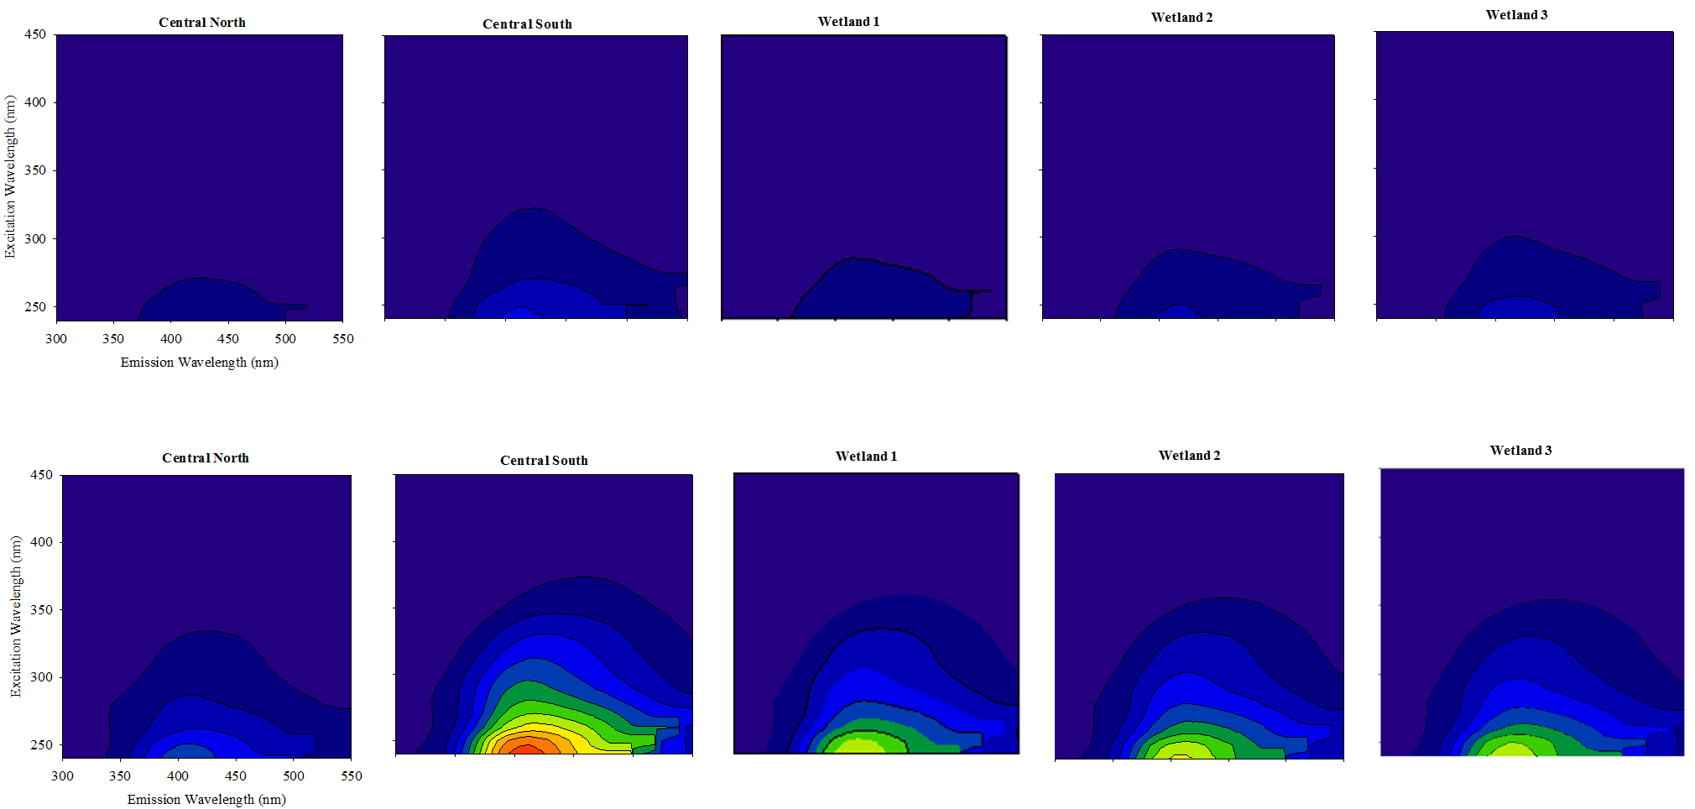
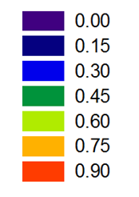
Results
Base Flow
Storm Flow

Slide 12
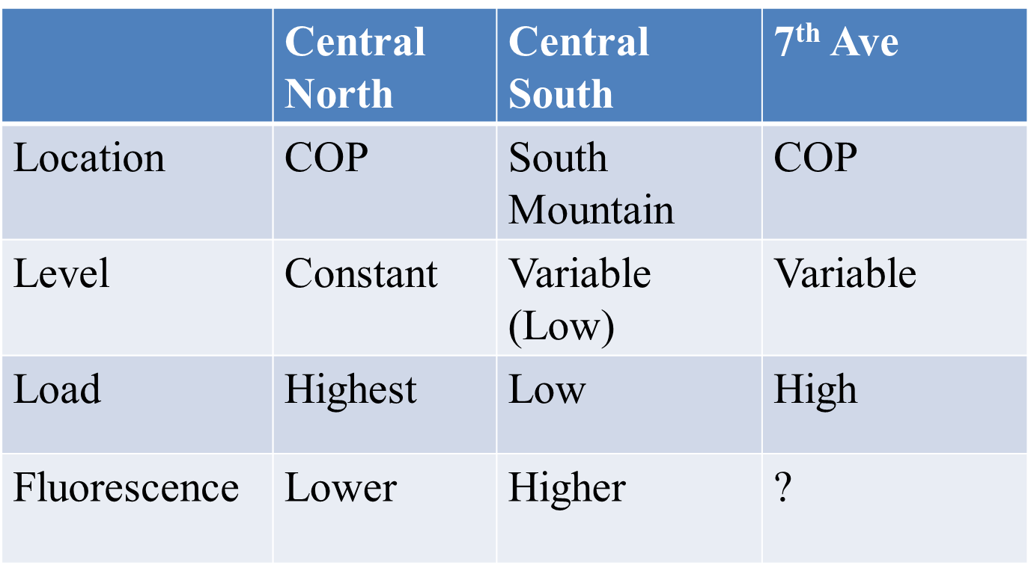
Conclusions
Inputs
Flowpath (upstream to downstream)
Difference in:
Base Flow and Storm Flow
Location relative to City of Phoenix
-Central North and 7th Ave
had the highest loads
No significant change in DOC in wetlands
- Wetland 1 and 4 high
loads
2. Change in composition

Slide 13
Questions?

